Slide 1
TEAM ENTROPY BRAINSTORMING IDEAS FOR COMPONENTS

Slide 2

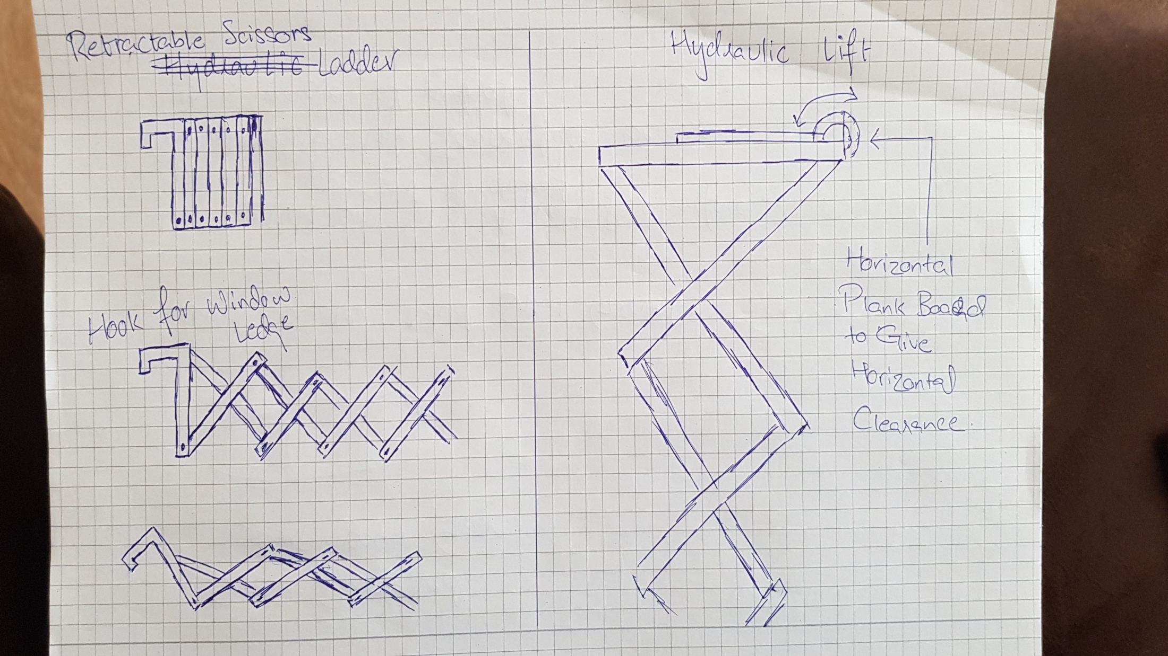




Slide 3
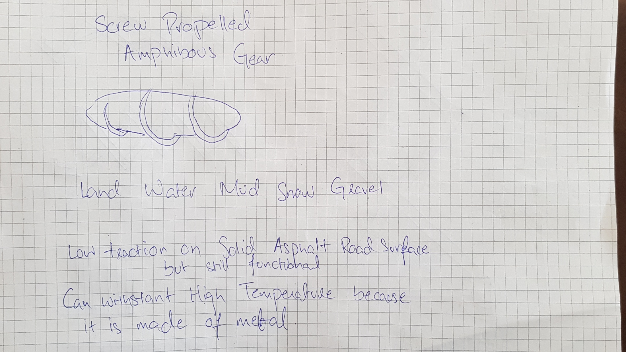
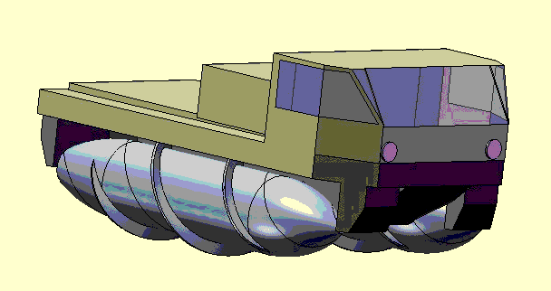

Slide 4
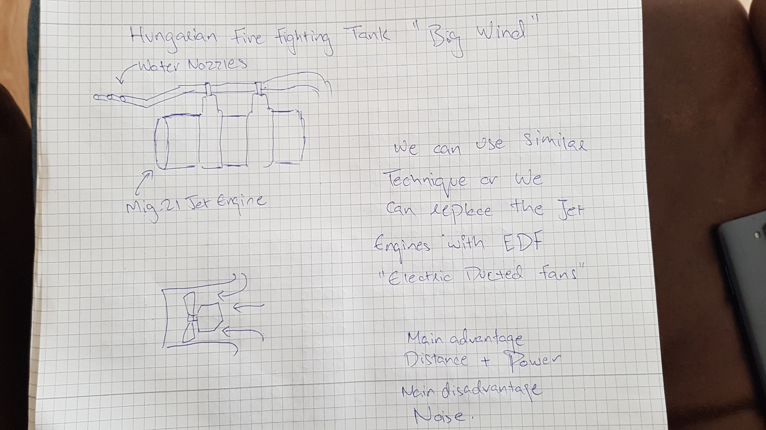
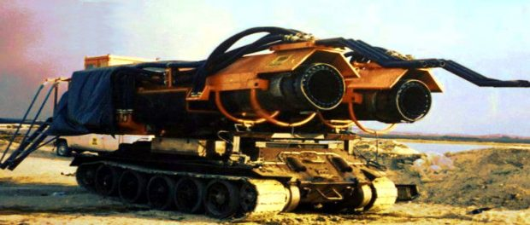


Slide 5
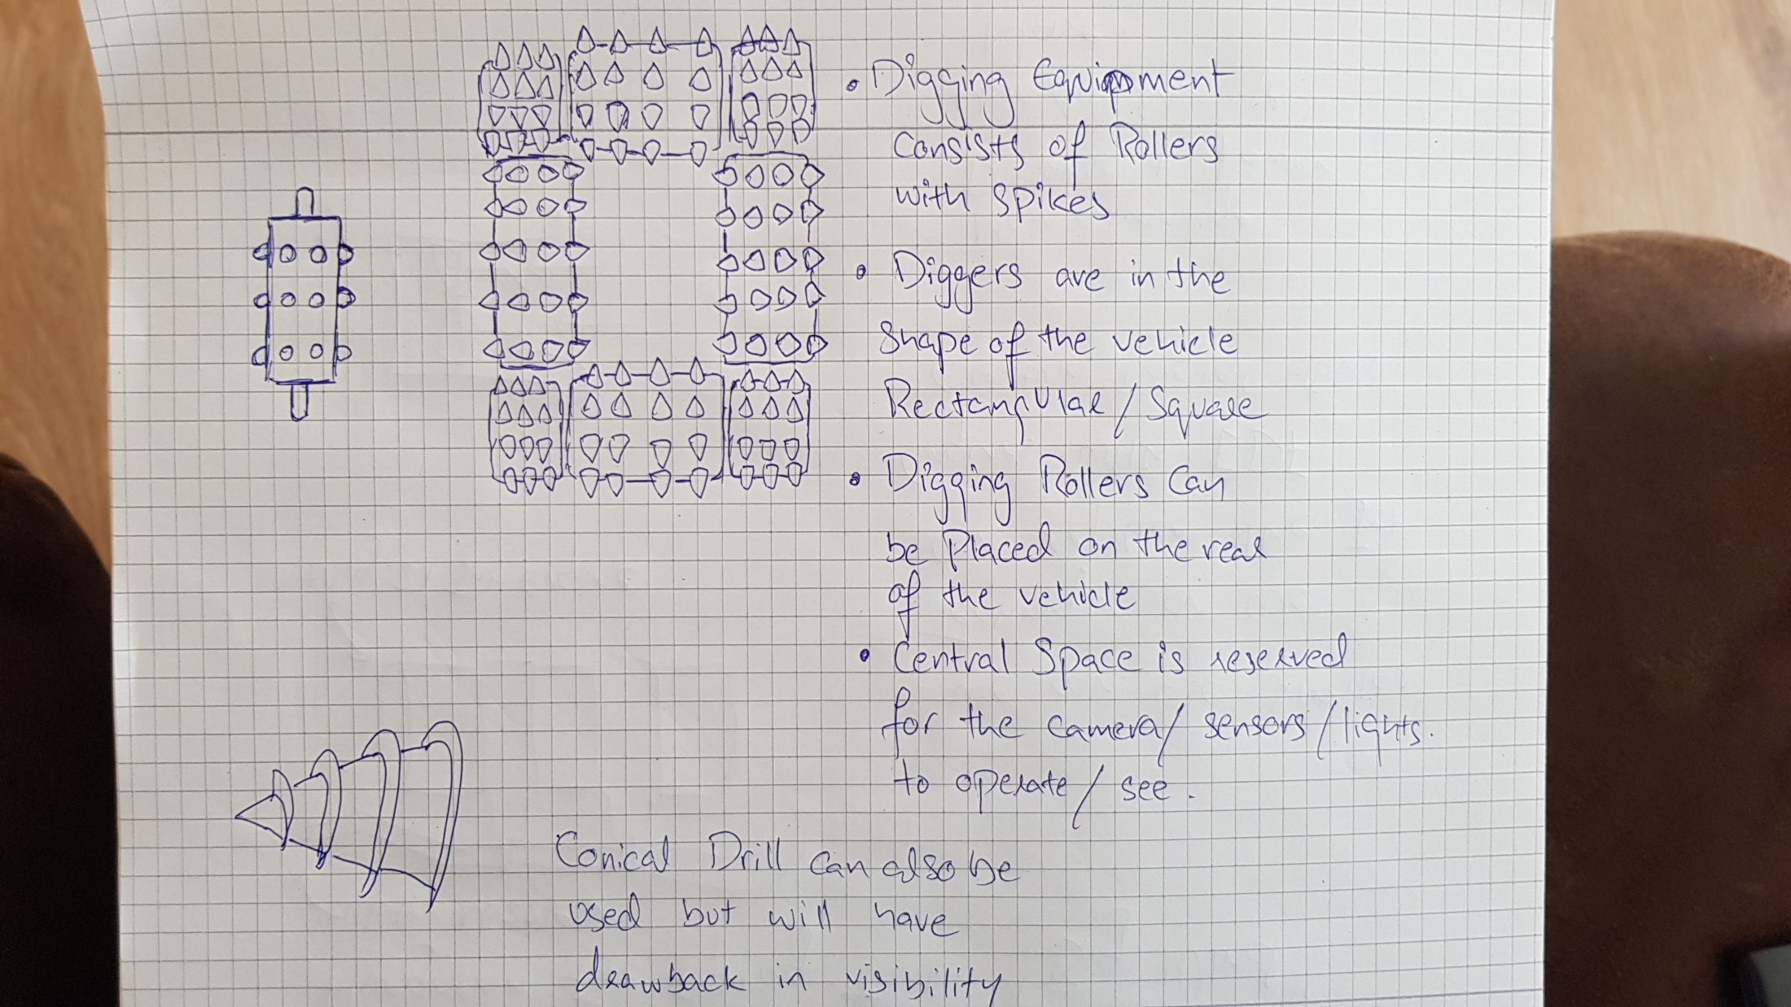
Multi-Threading
Multithreading is a specialized form of multitasking and a multitasking is the feature that allows your computer to run two or more programs concurrently.
In general, there are two types of multitasking:
Process-based multitasking handles the concurrent execution of programs.
Thread-based multitasking deals with the concurrent execution of pieces of the same program.

Slide 6
Brainstorming Sources
https://www.core77.com/posts/15191/solutions-to-stairs-part-2-folding-scissor-steps-15191
https://www.youtube.com/watch?v=nVOaDfGOPGs
https://www.youtube.com/watch?v=j7Ss3BMrscE
https://www.lausitzer-allgemeine-zeitung.org/big-wind-zwei-riesige-triebwerke-montiert-sind-sie-auf-einem-panzerfahrgestell/

